Slide 1
Time Averaging
Steven A. Jones
BIEN 501
Monday, April 14, 2008

Slide 2
Time Averaging
Major Learning Objectives:
Apply time averaging to the momentum and energy transport equations.

Slide 3
Time Averaging
Minor Learning Objectives:
Define a time average.
State reasons for time averaging.
Demonstrate how linearity and nonlinearity affect time averaging.
Demonstrate the main rules for time averaging.
Compare time averaging to linear filtering.
Time average the momentum equation.
Describe Reynolds stresses.
Time average the energy equation.
Describe turbulent energy flux.

Slide 4
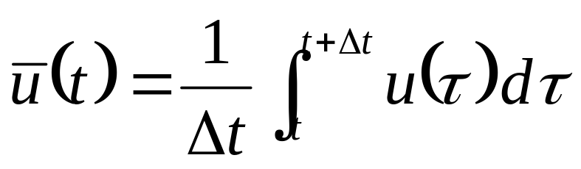
Definition of a Time Average
If we have a variable, such as velocity, we can define the time average of that variable as:
What is t?
What is Δt?
How can u(t) be a function of time if it is time-averaged?

Slide 5
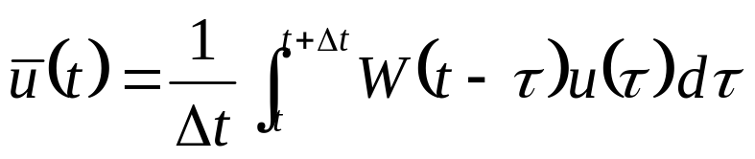
Definition of a Time Average
Time averaging is a special case of a linear (low pass) filter (moving average).
Where W(t) is a weighting window.
You should recognize this form as a convolution (or cross-correlation) between the weighting function and the variable of interest.

Slide 6
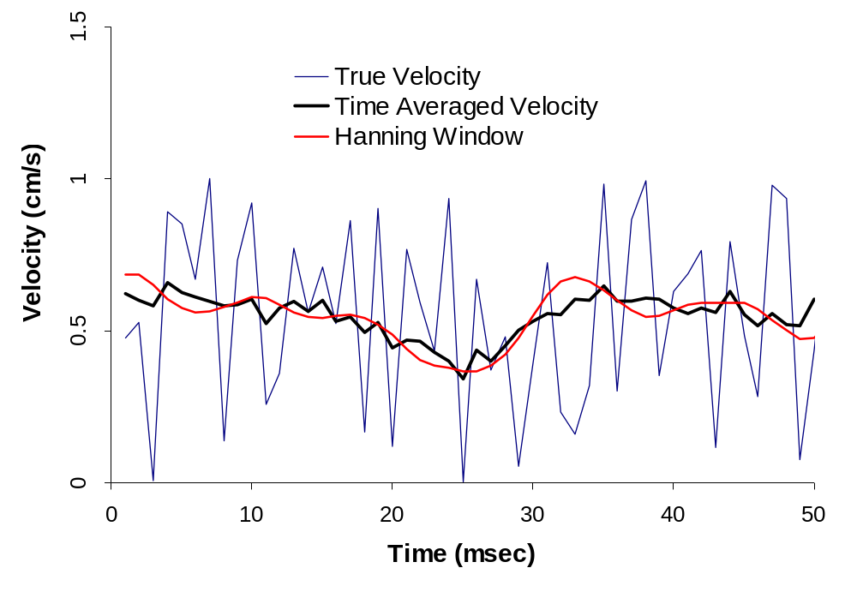
What are t and Δt?
The definition is a moving average, and t is the time at which the window is applied.
Δt
In this example, Δt is 10 msec.

Slide 7

Long Time/Short Time
When we talk about u(t), t is referred to as short time.
When we talk about , t is referred to as long time.

Slide 8
Why Time Average?
We may be interested in changes that occur over longer periods of time.
We may want to filter out noise in a signal.
Measurements are often filtered. All instruments have some kind of time constant.
Examples:
Do weather patterns suggest global warming?
What is the overall flow rate from a piping system?
What is the average shear stress to which an endothelial cell is subjected?

Slide 9
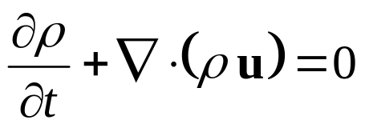
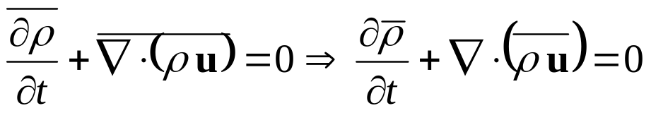
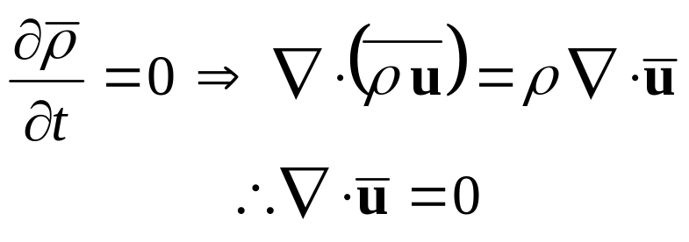


Continuity and Linearity
The equation of continuity is:
The time average is:
If density is constant:
When an equation is linear, the time average for the equation can be found simply by substituting the time averaged variable for the time dependent variable. E.g. incompressible continuity is and time-averaged incompressible continuity is .

Slide 10
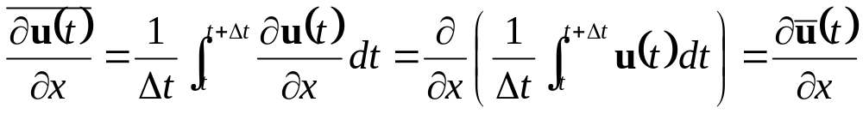
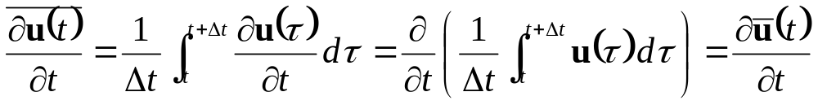
Consequences of Linearity
The time average of a derivative is the derivative of a time average.
The same result holds for time derivatives:

Slide 11
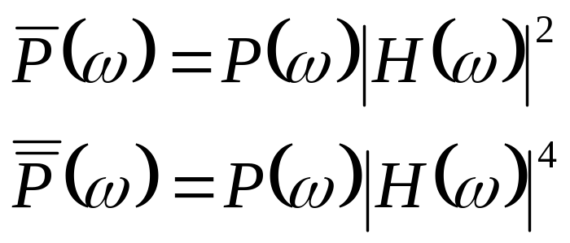
Time Averaged Time Average
From linear systems, a signal filtered twice is different from a signal filtered once, as can readily be seen from the frequency domain.
But if the slow fluctuations are sufficiently separated in frequency from the fast fluctuations, the average of the average is approximately the same as the average.
In particular, for fluctuations in steady flow, the two averages are the same.

Slide 12
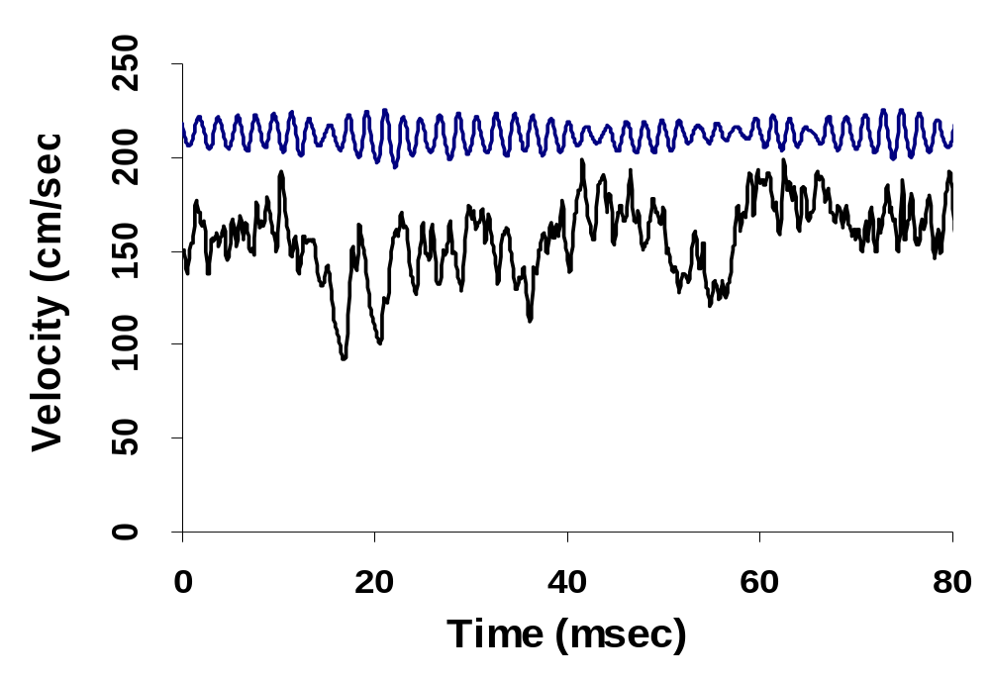
Sample “Steady Flow” Data
Disturbed
Turbulent
In each case, what is the “time average?”

Slide 13
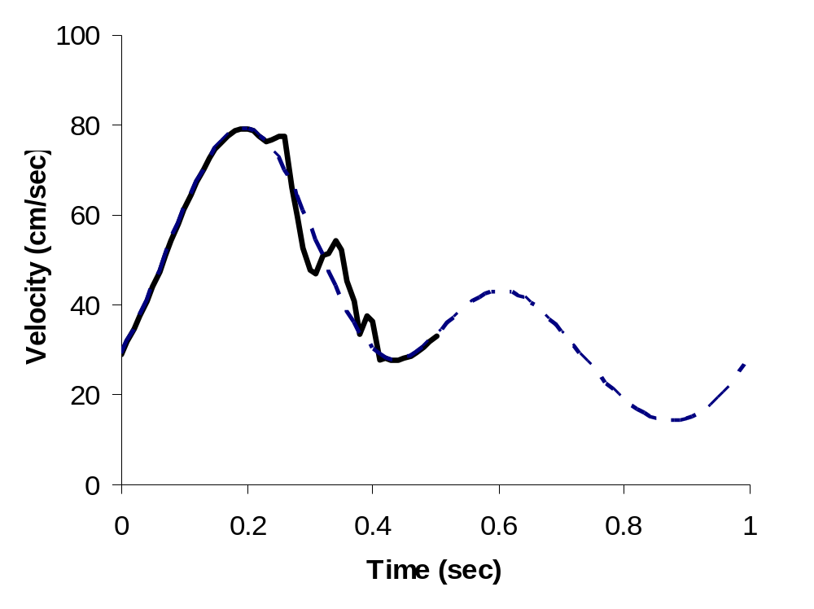
Is This Flow Disturbed?
What is the correct averaging time?

Slide 14
Choices
We need to determine what time frame we are interested. The time frame is determined by the value of Δt.
How does the earth’s rotation affect temperature? (Δt ~ hours)
How does the earth’s tilt affect weather? (Δt ~ days)
How does the earth’s magnetic field affect weather? (Δt ~ years)

Slide 15
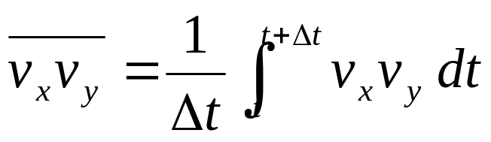


Consequences of Nonlinearity
The time average of a product is not the product of time averages.
We will often divide a variable into two components, one of which is constant and one of which is time variant.
The time average becomes simply .

Slide 16


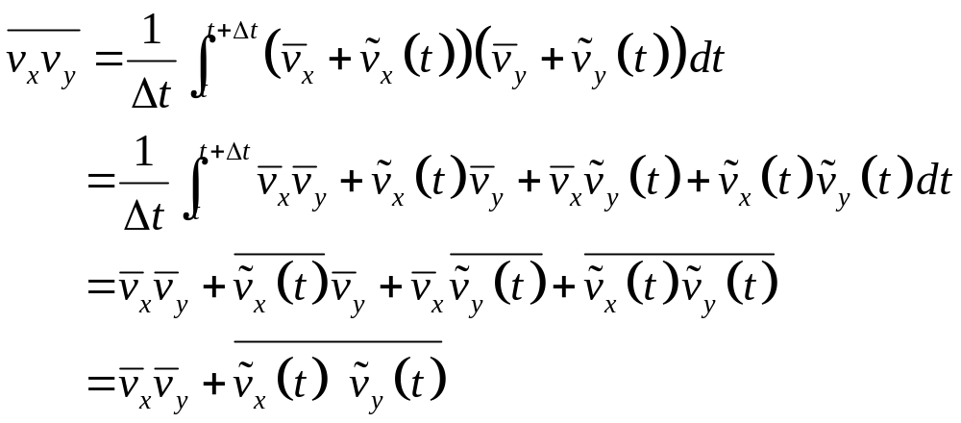
Consequences of Nonlinearity
With , since
it follows that .
The time average of the product becomes:

Slide 17
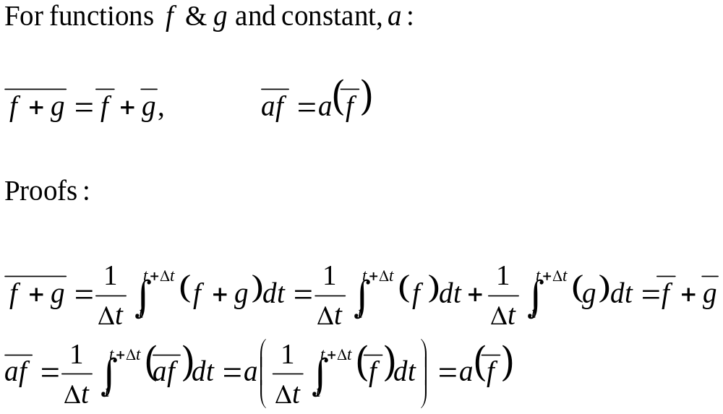
Additional Relationships

Slide 18
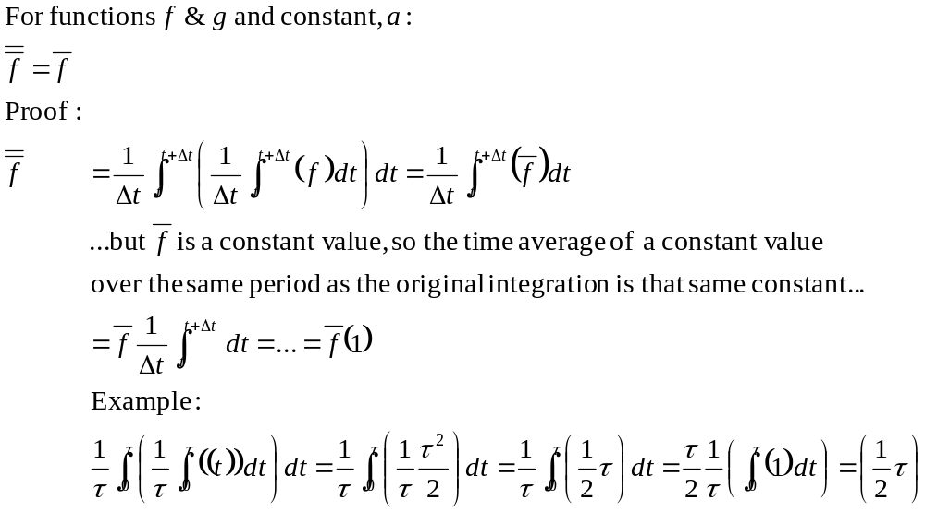
Additional Relationships

Slide 19
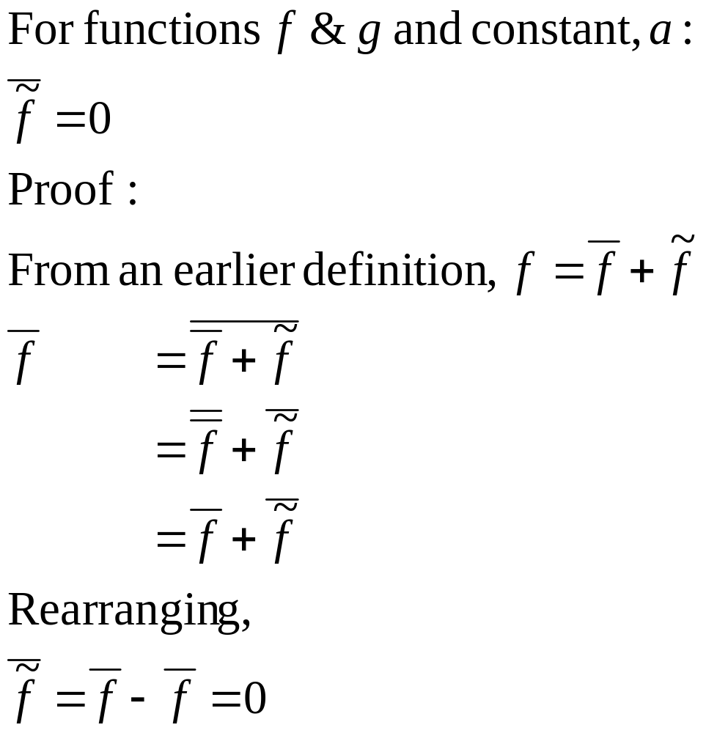
Additional Relationships

Slide 20
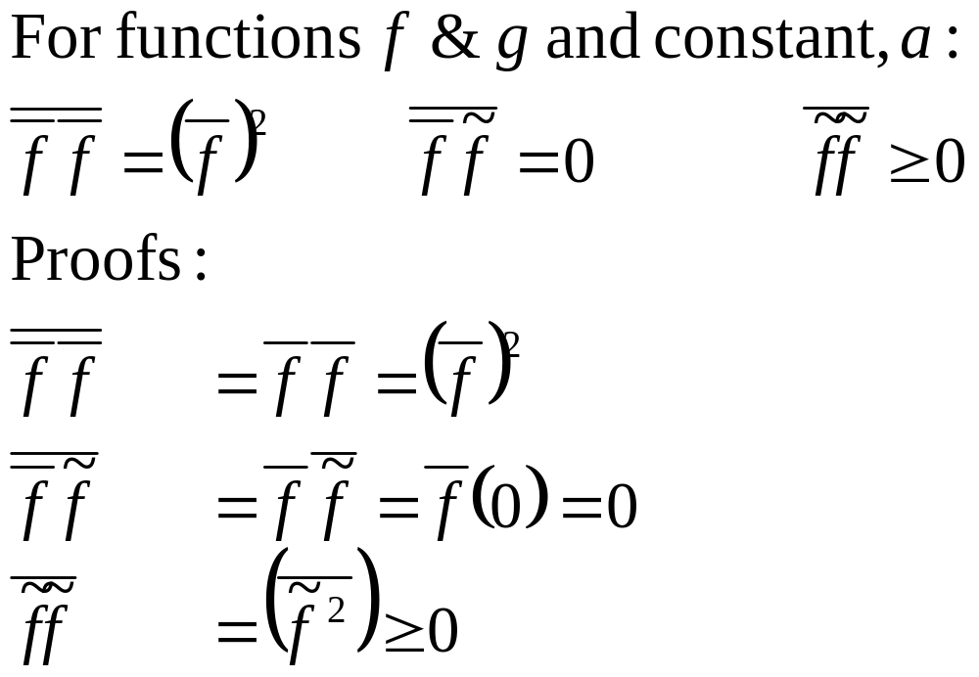
Additional Relationships

Slide 21
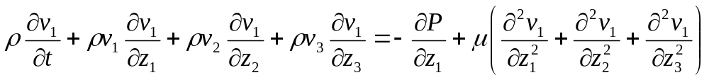
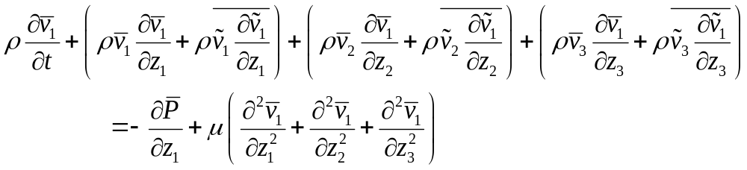
Time Averaged Momentum
Consider the z₁ Momentum Equation in the form.
Let ρ be constant and let:
Then:

Slide 22
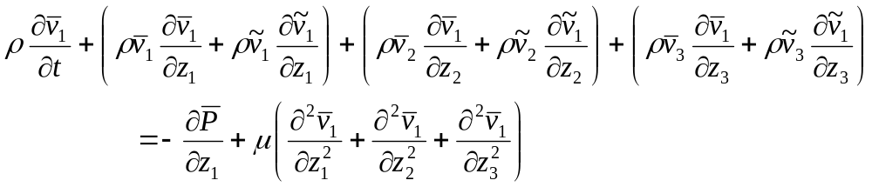
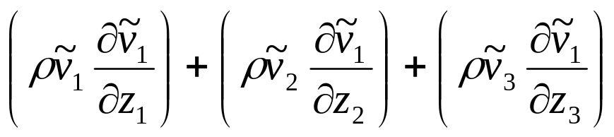
Time Averaged Momentum
The equation
Looks like the non time-averaged version, except for the extra terms:

Slide 23
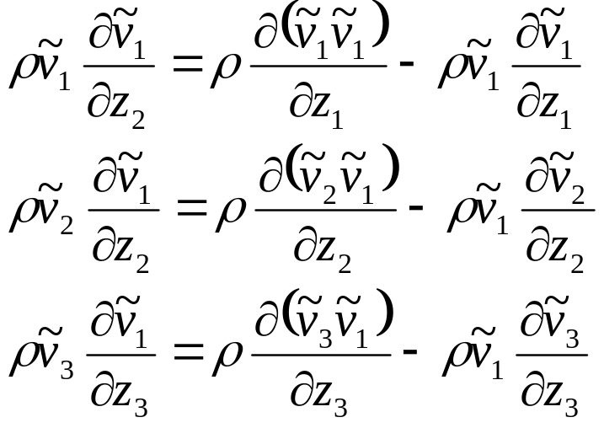
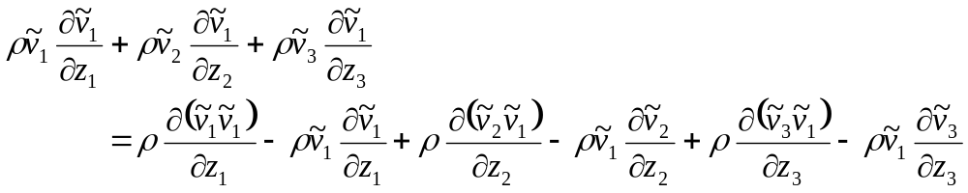
Time Averaged Momentum
Consider these terms, and apply the product rule for differentiation (in reverse):
Then:

Slide 24
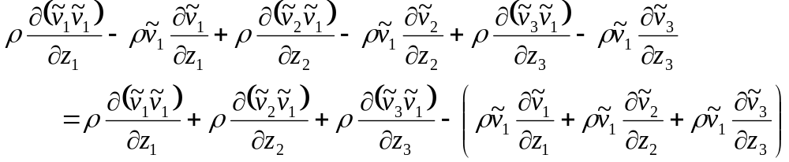
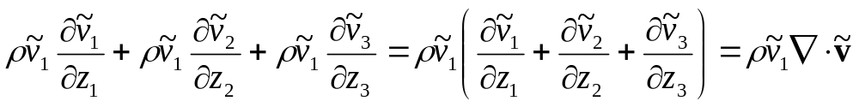
Time Averaged Momentum
Rearrange:
Then the term in parentheses is:
Which is zero by continuity.

Slide 25
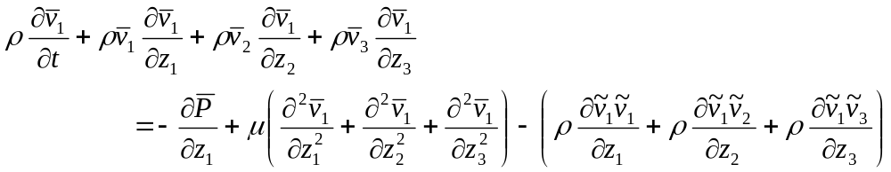
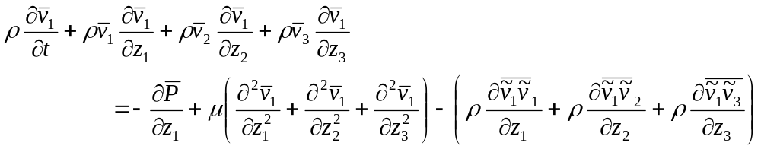
Time Averaged Momentum
Now take the time average:
To get:

Slide 26
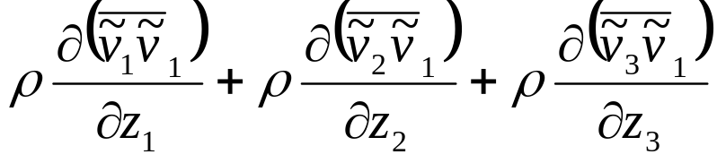
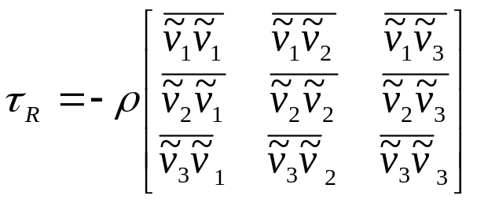
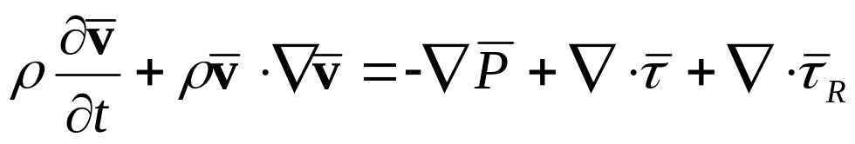
Time Averaged Momentum
The terms:
Look like the divergence of a second order tensor defined by:
Consequently, it is customary to write the time averaged momentum equations in the form:

Slide 27
Reynolds Stresses
Have the form of a stress tensor.
Act as true stresses on the mean flow.
Are referred to in the biomedical engineering literature relating cell damage and platelet activation to turbulence.
But are not the stresses directly imposed on the cells. (Viscous shearing).

Slide 28
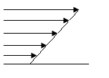
Reynolds Stresses
If an eddy of fluid suddenly move through the velocity field:
The fluid would tend to change the local momentum.
Thus, the Reynolds Stress is not a shear upon the fluid itself, only upon the velocity field.
  THIS IS A VERY IMPORTANT DISTINCTION

Slide 29
Reynolds Stresses
Cell Damage
  Since cells such as Red Blood Cells (RBC), monocytes, and platelets can be affected by shearing, it is important to determine the degree of shearing to which a cell is subjected in a given flow geometry.
  This is particularly important in regions of turbulence such as downstream of a stenosed valve or downstream of tight vascular constrictions.

Slide 30
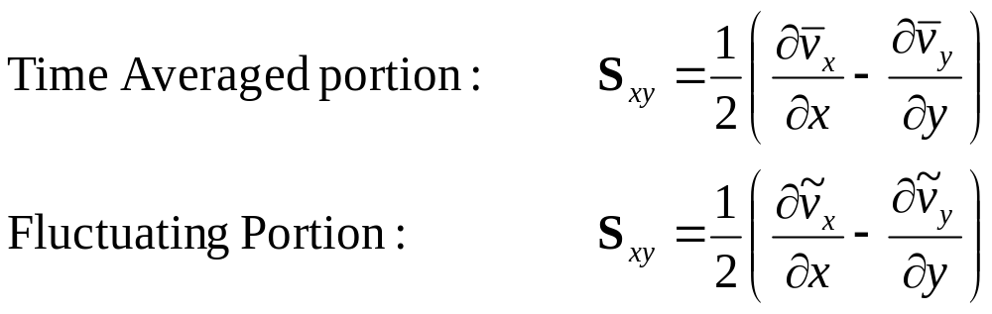
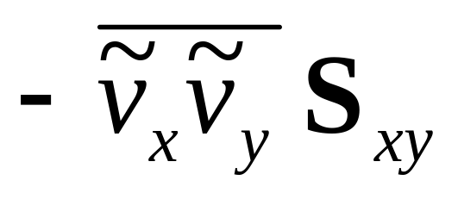
Reynolds Stresses – 2D Flow
If the rate of strain is given as follows:
Then we can write the energy extracted from the mean flow and converted to turbulent fluctuations due to strain rate as:

Slide 31
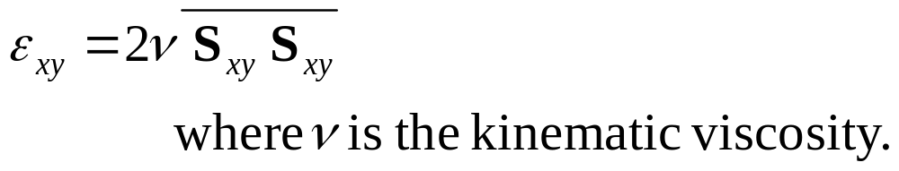
Reynolds Stresses – 2D Flow
The energy which is extracted from the turbulent kinetic energy and converted to heat through viscous shearing is called viscous dissipation and is designated by ε

Slide 32
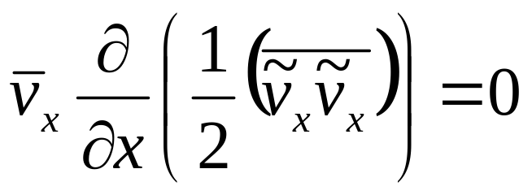
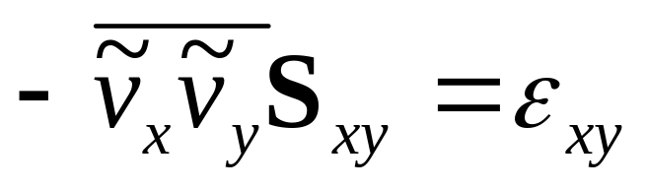
Reynolds Stresses – 2D Flow
Then in homogeneous steady flow such that
It follows that over the entire turbulent region,

Slide 33
Reynolds Stresses – 2D Flow
There are several mechanisms that can damage blood cells. Two of these are pressure fluctuations and shear stress.
  Pressure fluctuations are generally more important for larger particles since a net shear on the particle requires a difference in pressure along its length.
  Shearing is a more likely mechanism for damage in cells the size of RBC.

Slide 34
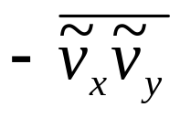
Reynolds Stresses – 2D Flow
The Reynolds Stresses, , are often used as a measure of the stresses on the individual cells.
Even though are called Reynolds Shearing Stresses, they do not represent the shearing stresses on individual cells.
  Rather, they are the stresses on the mean flow field, as stated before.

Slide 35
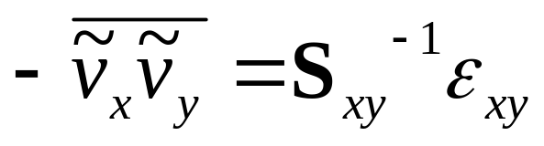
Reynolds Stresses – 2D Flow
It is, however, much easier to measure the Reynolds Stresses than it is to measure the viscous dissipation
  Because the Reynolds Stresses occur over a much larger scale than the viscous stresses.
  Thus, we use this identity to estimate the viscous dissipation, and thus total stresses on the flow from the Reynolds Stresses.
How would you measure the Reynolds Stresses?

Slide 36
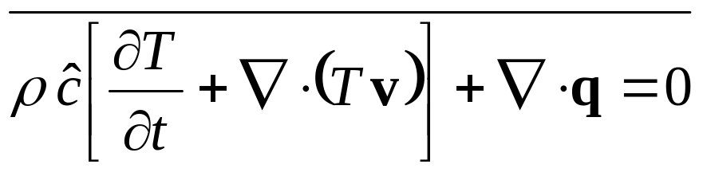
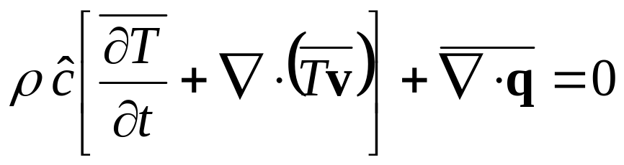
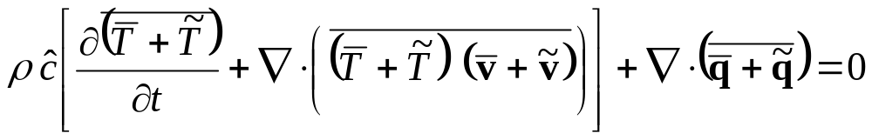
Time Averaged Energy Equation

Slide 37
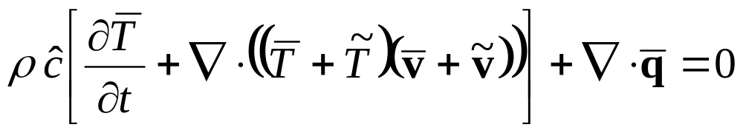
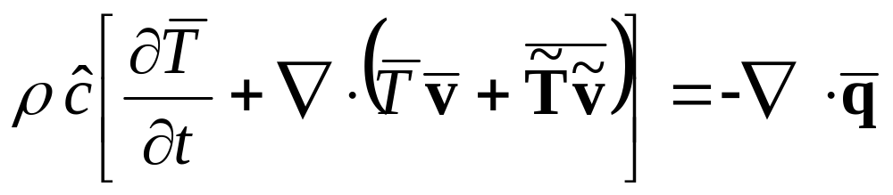
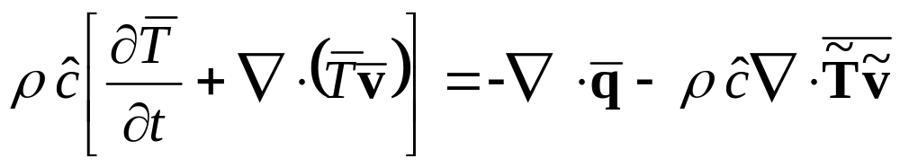
Time Averaged Energy Equation
From:
The cross terms between time averaged and fluctuating values again become zero.
So:

Slide 38
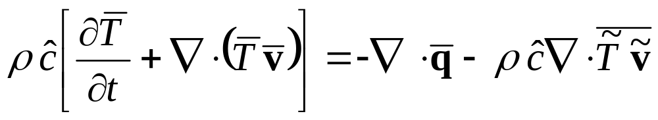
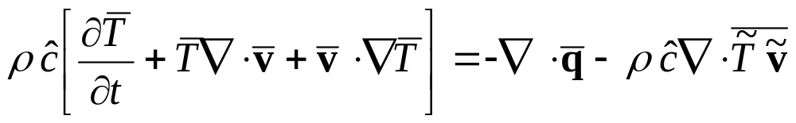
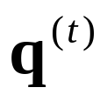
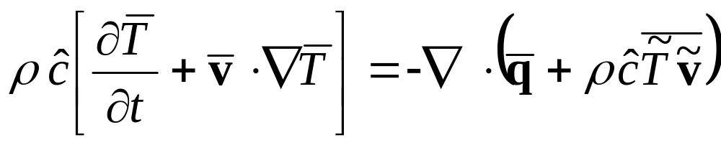
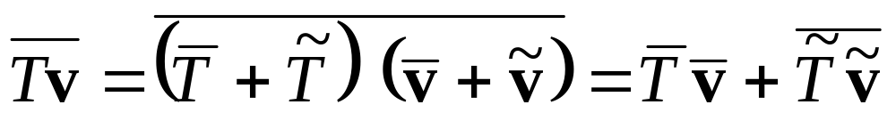
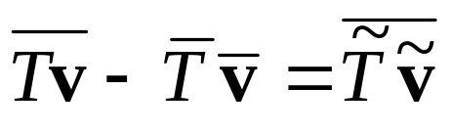
Time Averaged Energy Equation
From:
Apply the product rule:
(Incompressible)
Same as in book because:
So

Slide 39
Use of Turbulent Energy Flux
Solutions to the energy equation depend on finding empirical and semi-theoretical relations for the turbulent energy flux.
Turbulent energy flux will depend on temperature gradient and the stress tensor.
Turbulence tends to transport energy, momentum and mass through mixing. I.e. turbulence carries things across “mean streamlines” and distributes them more evenly.

